Slide 1

Microsoft Ignite NZ
25-28 October 2016
SKYCITY, Auckland

Slide 2
Building, Testing and Deploying a Browser Extension in Microsoft Edge
M357
Scott Low

Slide 3
Agenda
Introduction
Roadmap
The Journey of an Extension Developer
Building an extension in Chrome
Porting an extension to Edge
Using F12 to debug an extension
Testing extensions with Microsoft WebDriver
Packaging and deploying an extensiion

Slide 4
Introduction

Slide 5
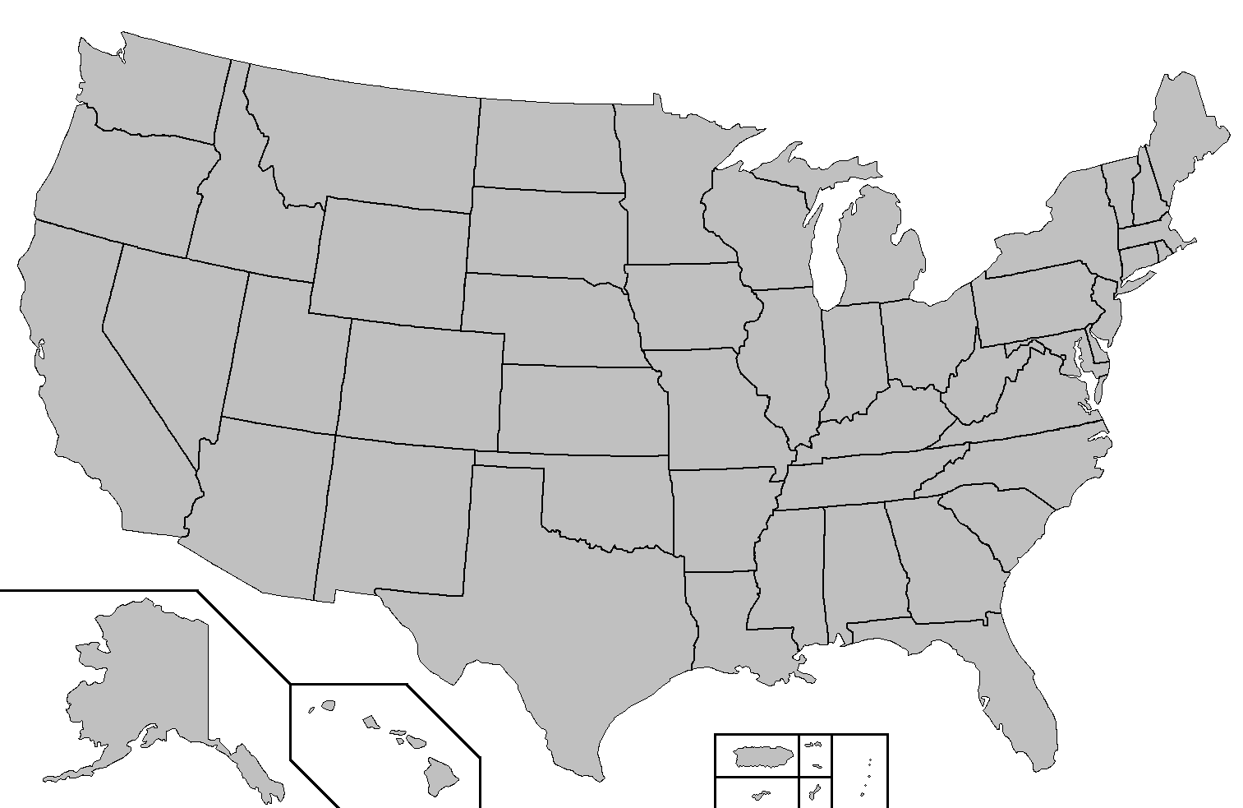
Introduction Who am I?
Scott Low (@_scottlow on Twitter)
PM for the Web Platform Team (WPT)
Helping to bring extensions to Edge!

Slide 6
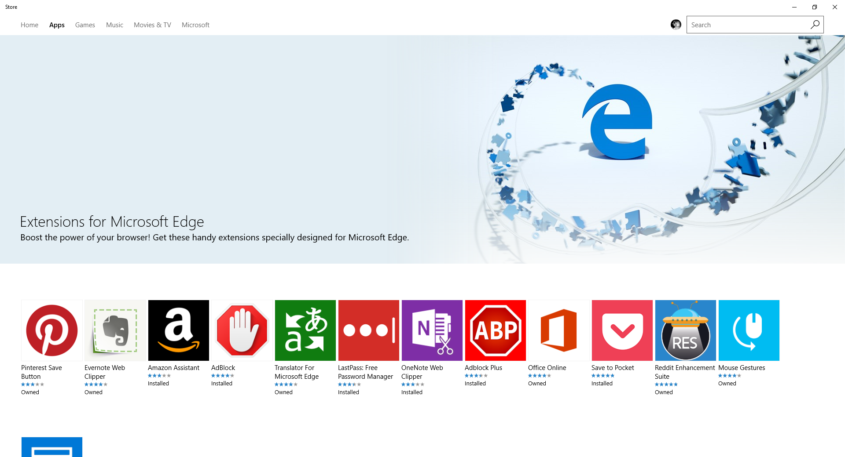
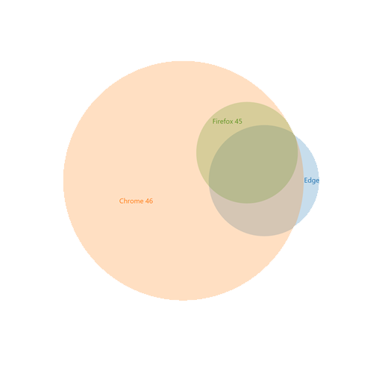
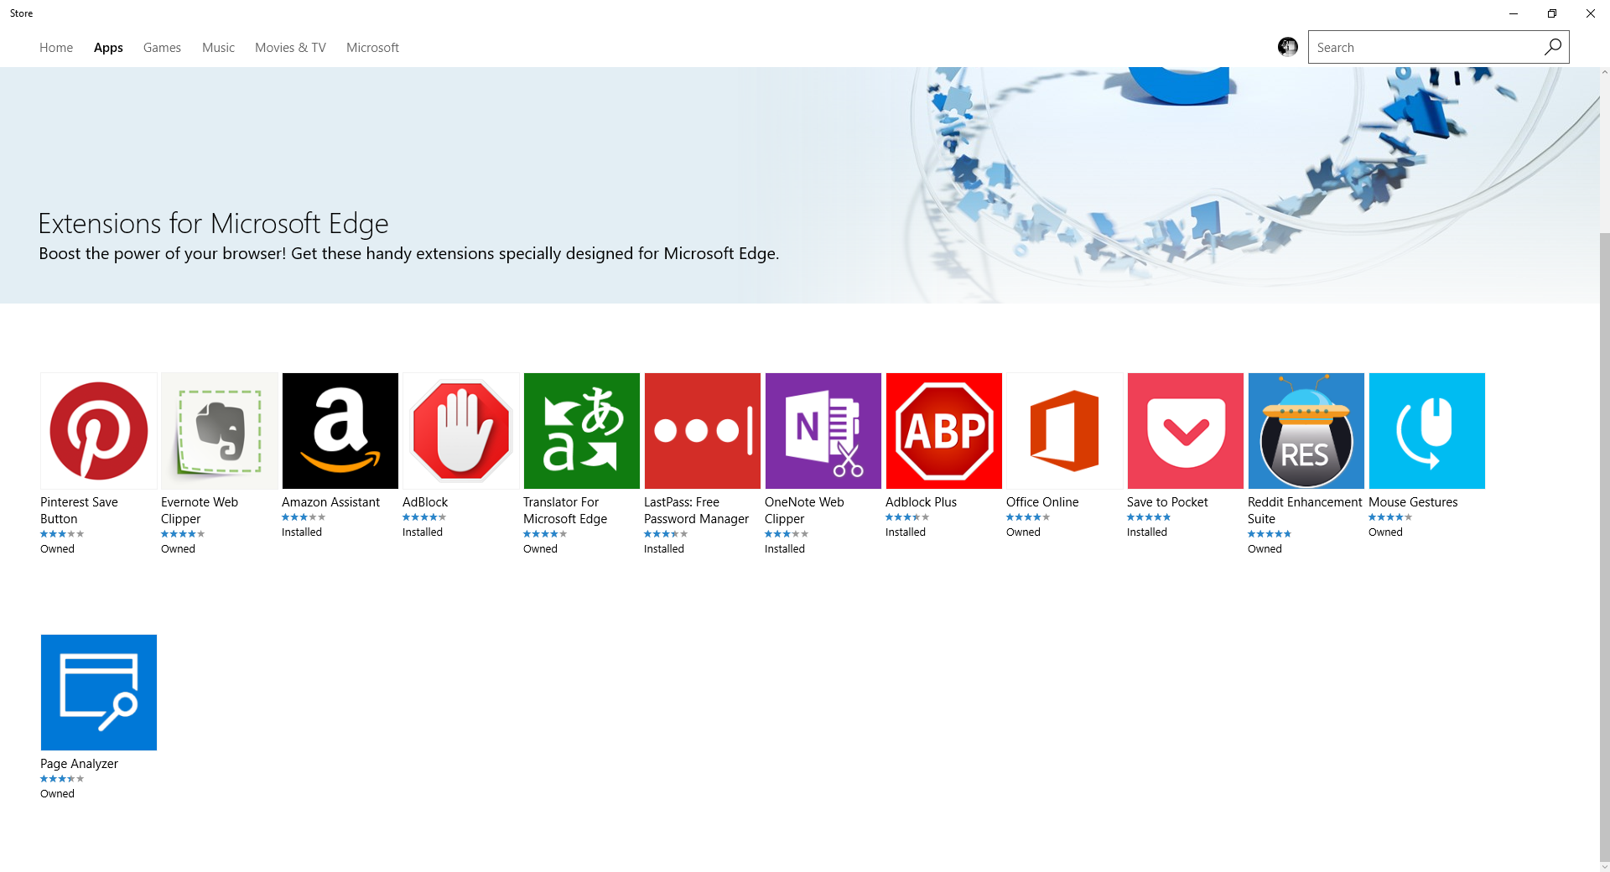
Introduction We shipped 13 top extensions in the Anniversary Update
194 Edge extension APIs
13 extensions available in Windows Store

Slide 7
Roadmap Our next release has plenty of features to get excited about
New APIs
Improved Testability
More top extensions
Improved developer experience
Better reliability and performance

Slide 8
Roadmap Our next release has plenty of features to get excited about
New APIs
Improved Testability
More top extensions
Improved developer experience
Better reliability and performance

Slide 9
The Journey of an Extension Developer

Slide 10
A Recap on Extension Architecture Three extension contexts tied together by messaging APIs
Extension Package
Manifest.json
Communication is achieved with two runtime APIs:
browser.runtime.sendMessage()
Browser.runtime.onMessage()
Background page
Content scripts
UI pages

Slide 11
The Journey of an Extension Developer Let’s see some code!
Microsoft Edge’s extension APIs were designed to be interoperable with Chrome’s
Let’s start there and see what it takes to port an extension to Edge!

Slide 12
Loading an Extension with Microsoft WebDriver

Slide 13
Packaging and Deploying an Extension

Slide 14
Q&A Thanks for coming out to learn about Edge Extensions!
Additional questions? Reach out to @MSEdgeDev or @_scottlow on Twitter
See www.github.com/scottlow/Ignite2016 for documentation and code samples
Submit a request to https://aka.ms/extension-request to be considered for a future update!

Slide 15
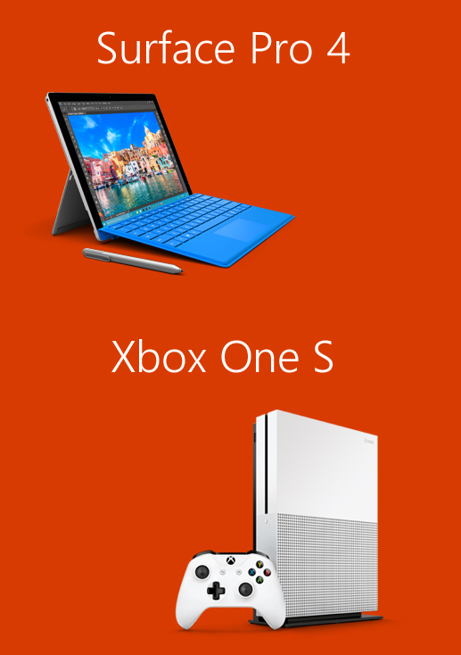
Please evaluate this session for the chance to instantly win great prizes like Surface Pro 4 and the brand new Xbox One S!
Your feedback is important to us!
From your PC or Tablet visit My Ignite at http://msignite.nz/my-ignite

